Slide 1


How to Build an API
with Firebase
Andrew Evans
Senior Software Engineer

Slide 2
Agenda
Intro
What is an API?
What is HTTP?
What is a RESTful service?
What is Firebase?
Sample Project
DEMO
Next Steps
Questions

Slide 3




Intro
12 years industry experience
10 years - HII NNS
2 years - Capital One
Masters in CS
MBA
Contributor to Angular-In-Depth
Open Source contributor (and fan)

Slide 4
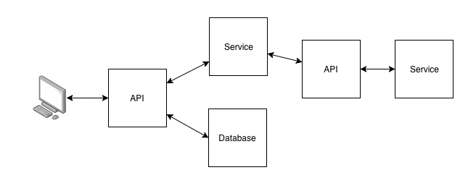
What is an API?
Application Programming Interface (API) is a set of functions and procedures allowing the creation of applications that access the features or data of an operating system, application, or other service -Google
(translation) how software systems communicate

Slide 5
What is HTTP?
HTTP = Hyper Text Transfer Protocol
Protocol used by browsers and web technologies to communicate
Common Verbs:
GET = retrieving data
POST = creating or updating data
PUT = updating data
DELETE = deleting data

Slide 6
HTTP Verbs
CRUD = Create, Read, Update, Delete
For more consult the MDN Docs here
POST | Create Operation, typically has an associated body
GET | Read Operation, typically has no body
PUT | Update Operation, typically has an associated body
DELETE | Delete Operation, typically has no body

Slide 7
What is a RESTful Service?
REST refers to Representational State Transfer,
Leverages HTTP Methods and W3C standards
Define REST in terms of Requests
Requests consist of:
HTTP Verbs
Headers
Request Parameters
Request Body
APIs contain RESTful Services that use the HTTP Protocol
to send and receive requests

Slide 8
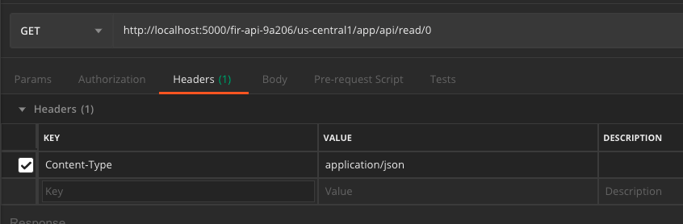
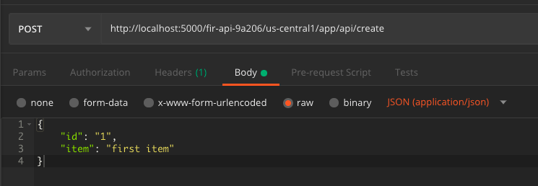
REST Request
Example GET Request:
Example POST Request

Slide 9
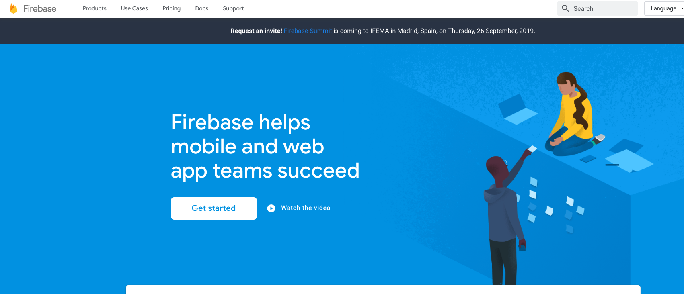
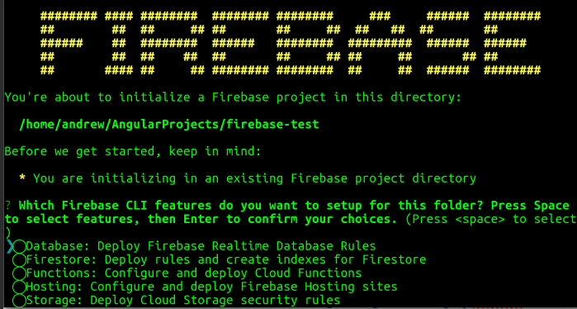
Firebase
Google Developer Mobile Platform
Free
Fun
Easy to Use
Pre-provisioned environment for developers to get up and running fast

Slide 10
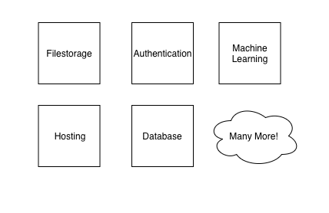
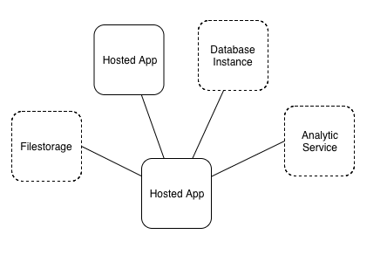
Firebase

Slide 11




Building an API with Firebase
Firebase Cloud Functions
ExpressJS
GitHub Project
Postman

Slide 12
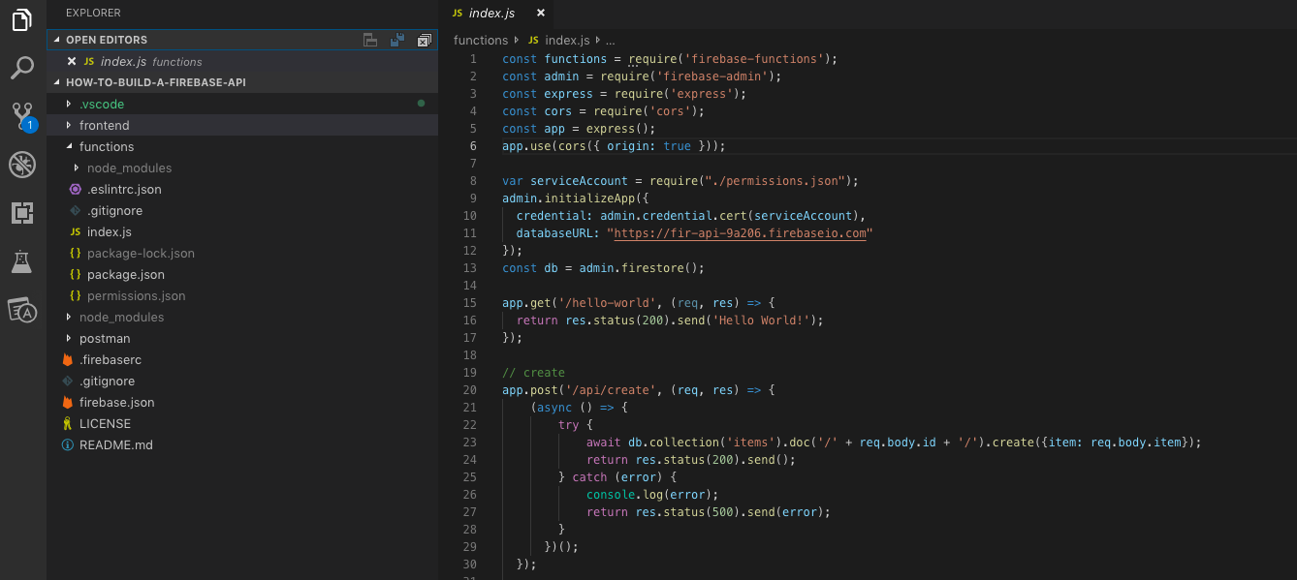
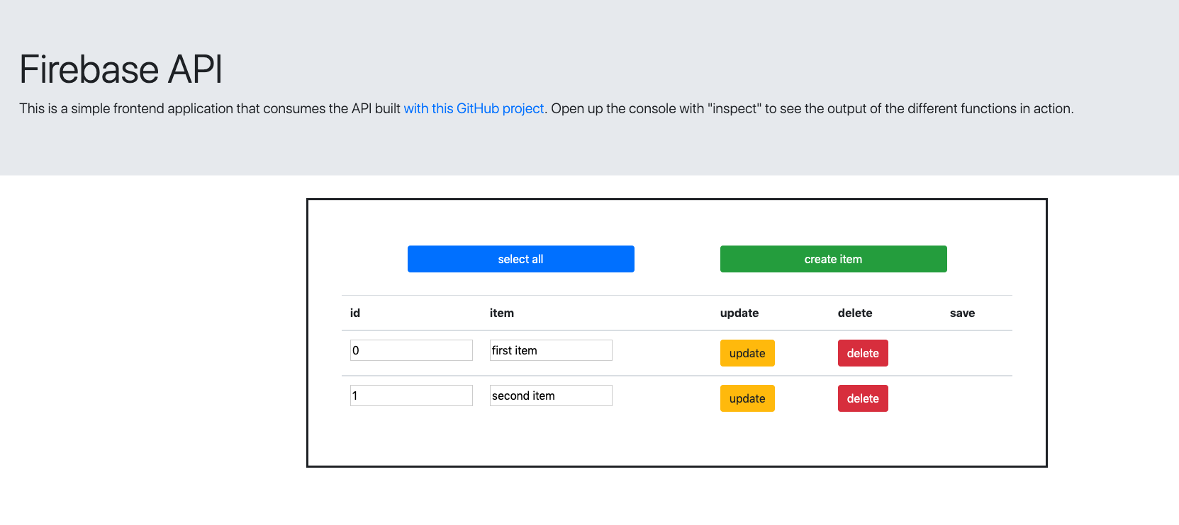
Example Application
GitHub Repo:
https://github.com/andrewevans0102/how-to-build-a-firebase-api
Blog Post:
https://blog.angularindepth.com/building-an-api-with-firebase-6108a207c1fd

Slide 13
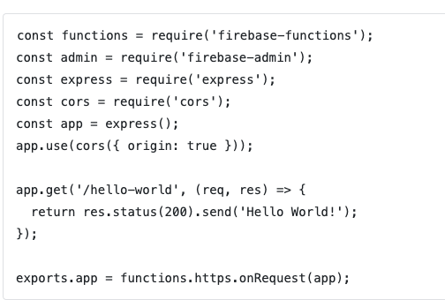
API Packages and ExpressJS
firebase-functions enables you to create functions
firebase-admin is the firebase admin SDK that connects your app to Firebase
express creates a Node server instance
cors is an npm module that allows your functions to run somewhere separate from your client. The app.use enables cors.

Slide 14
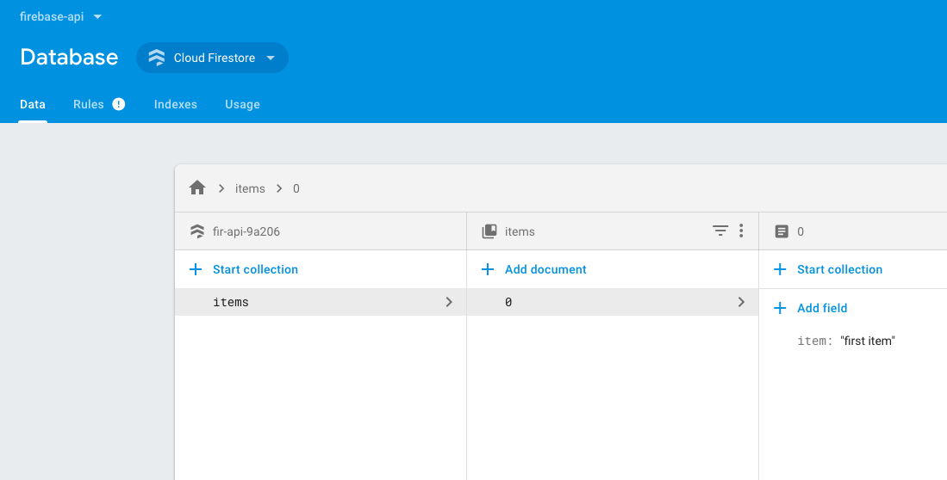
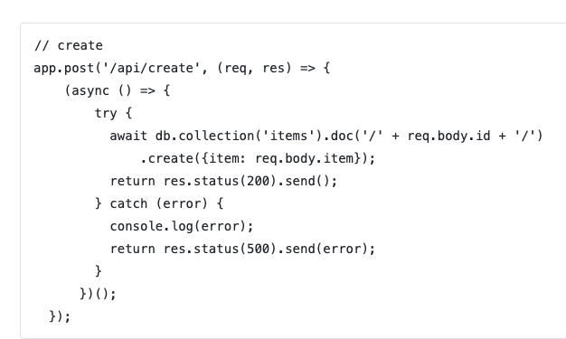
Database Calls

Slide 15
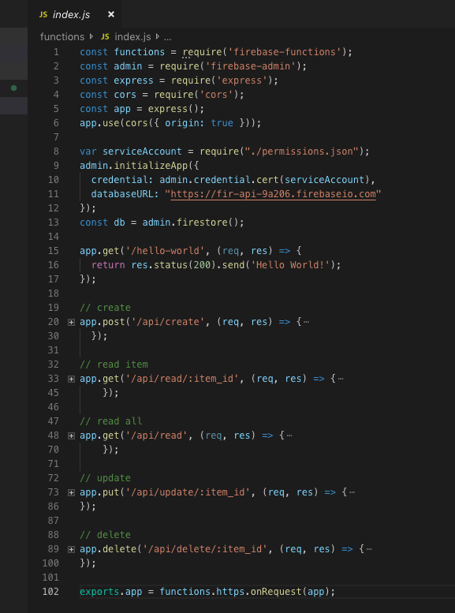
Endpoints
/create
(C) create item
/read-item/:item_id
(R) read a specific item (by ID)
/read-items
(R) read all items (total collection)
/update-item/:item_id
(U) update an item
delete-item/:item_id
(D) delete an item
Create, Read, Update, Delete = CRUD

Slide 16
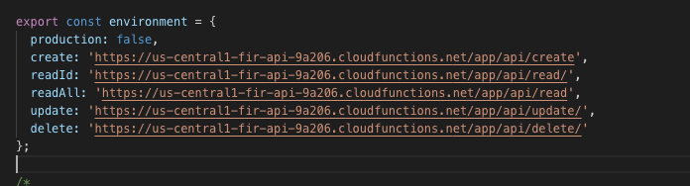
Frontend

Slide 17
LIVE CODING

Slide 18
Next Steps
Firebase
Why Firebase Cloud Functions are Awesome
How the AngularFire Library makes Firebase feel like Magic
Why Building with a JAMstack is Awesome

Slide 19
Thank you!

